Slide 1
Rajesh Ranjith
Portfolio Presentation T1A2

Slide 2
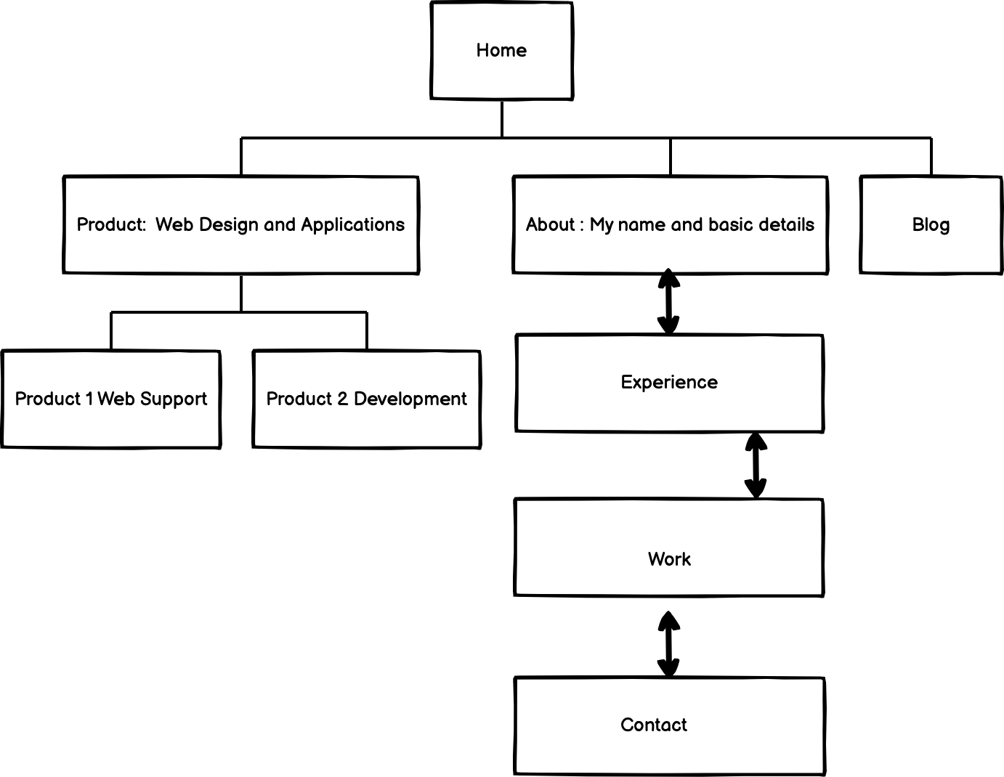
Site Map
Notes:
Add RESUME to WORK

Slide 3
About Me
Morbi leo mi, nonummy eget, tristique non, rhoncus non, leo. Nullam faucibus mi quis velit. Integer in sapien. Fusce tellus odio, dapibus id, fermentum quis, suscipit id, erat. Fusce aliquam vestibulum ipsum. Aliquam erat volutpat. Pellentesque sapien. Cras elementum. Nulla pulvinar eleifend

Slide 4
Experience
Morbi leo mi, nonummy eget, tristique non, rhoncus non, leo. Nullam faucibus mi quis velit. Integer in sapien. Fusce tellus odio, dapibus id, fermentum quis, suscipit id, erat. Fusce aliquam vestibulum ipsum. Aliquam erat volutpat. Pellentesque sapien. Cras elementum. Nulla pulvinar eleifend

Slide 5
Work
Morbi leo mi, nonummy eget, tristique non, rhoncus non, leo. Nullam faucibus mi quis velit. Integer in sapien. Fusce tellus odio, dapibus id, fermentum quis, suscipit id, erat. Fusce aliquam vestibulum ipsum. Aliquam erat volutpat. Pellentesque sapien. Cras elementum. Nulla pulvinar eleifend

Slide 6
Contact
Xxxxxxxxxx
Xxxxxxxxx
Xxxxxxx
Xxxxxx
1111

Slide 7
Target Audience
Professionals in the I.T. industry.
General business sector.
Recruiters.

Slide 8
General Design & Aesthetic
Simple and Easy layout for a positive user experience.
The site will have all information on the first page , hopefully when the user clicks on a heading , it will expand to reveal all the information.
The images and the amount of text on the site will be limited to provide ONLY useful information.
Minimalistic & Responsive design style is used.

Slide 9
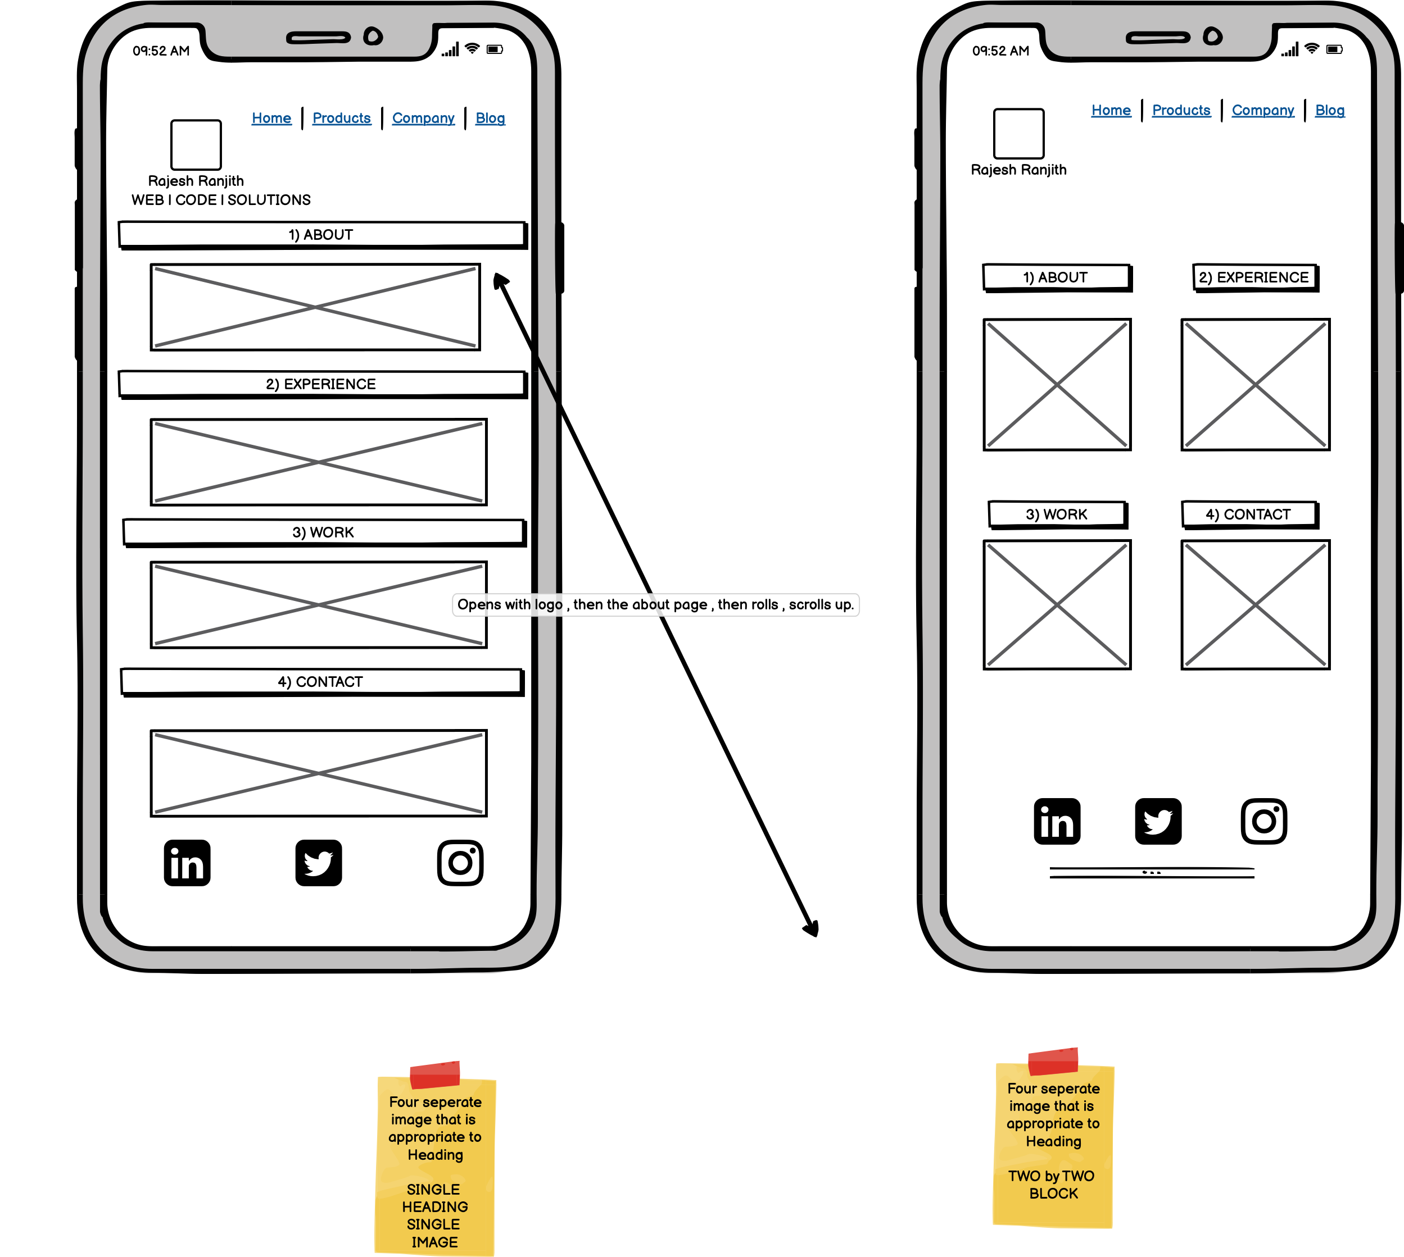
Mobile Layout

Slide 10
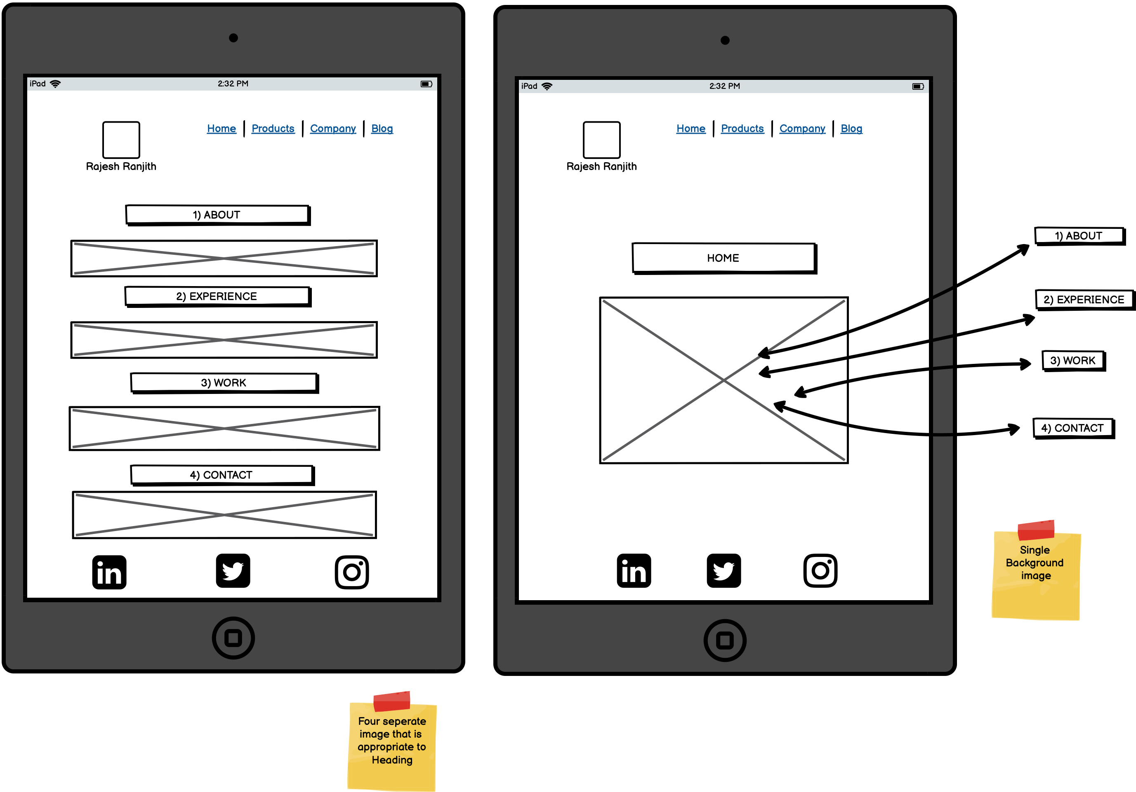
Tablet Layout

Slide 11
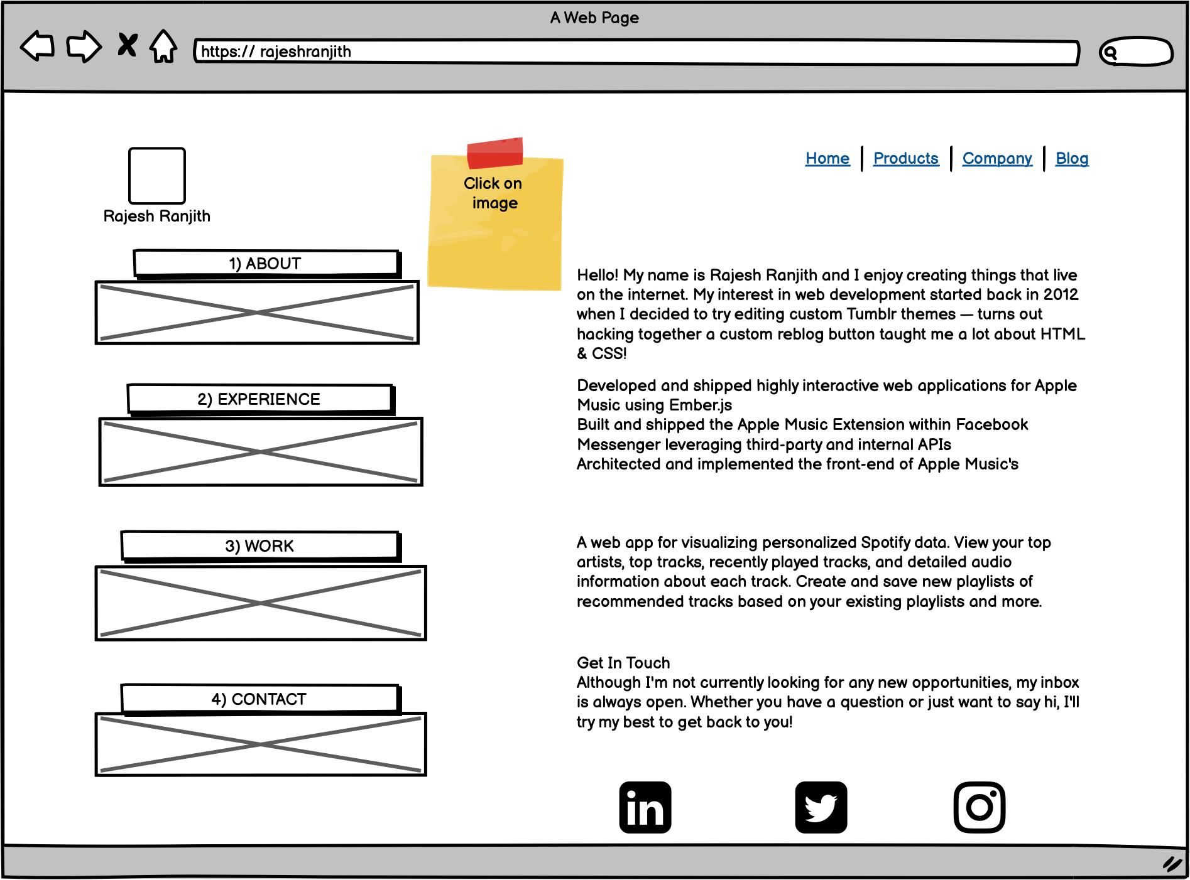
Website layout

Slide 12
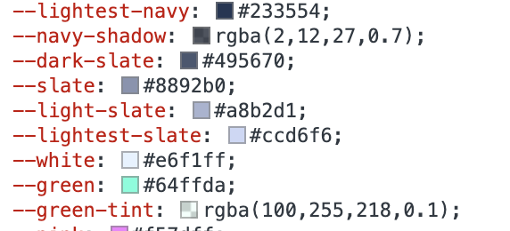
Design Style
Simple Colors
Black background.
Grey and Green color text.
Medium Font Size

Slide 13
Elements To Consider
Navigation – Easy and helpful for the user.
Visual Design – To depict my sense of professionalism and trustworthiness.
Content – Informative, Easy to read , and Concise.
Web Friendly – Ensure my Web Project works on different browsers.
Interaction – Make the site engaging.
Information Accessibility - Keep information easy to access on site.
Intuitiveness – Landing page direct and relevant.
Branding –The site must be a reflection of me and my business. I will aim to make a visual connection between my logo , my other brand material and my business and me .

Slide 14
Interactive aspects considered
Animations
Buttons
Video
Social Media Sharing Buttons
Quiz| Survey |Polls
Interactive Infographics

Slide 15
Components
Top NAV bar will be used
to move about the different pages.
Hover effect over the icon should slightly enlarge it to make the tab more visible to the user.
(I will attempt to add) transition color over certain tabs to highlight it.

